Slide 1

Factors That Affect Basketball Player’s Salary
Team 7
Anthony Nguyen
Helen Au
Shadi Salama
Warren Vince Sy

Slide 2
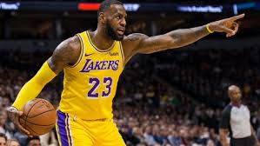
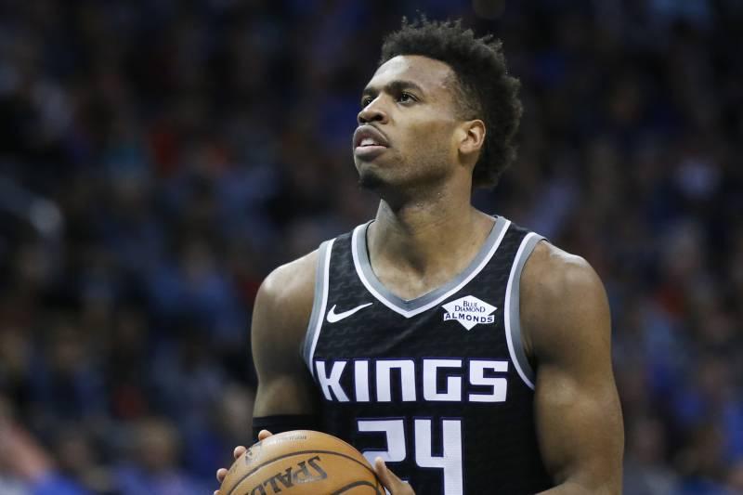
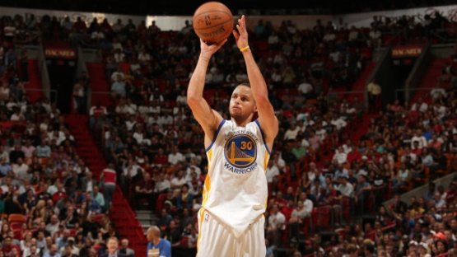

Content
Core hypothesis and main questions
Data source
Data cleaning
Analysis process
Conclusions
Findings
Q&A

Slide 3

Main Questions and Core Hypothesis
Question 1
Is the player position affect the player salary?
Question 2
What are the top factors that affects the players salary?
Question 3
What Stat does each California Team value?

Slide 4
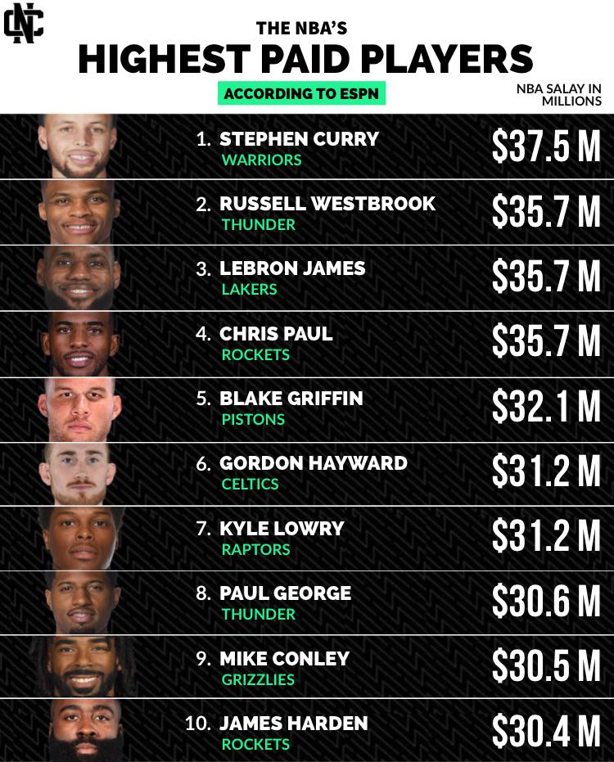
Questions and Data
We were curious of the highest paid basketball players of NBA but decided to focus on just California NBA Players to explore our local teams.
We wanted to find correlations and patterns to answer our question of what affects basketball salaries.
We were inquiring about why there were such gaps in salaries.

Slide 5
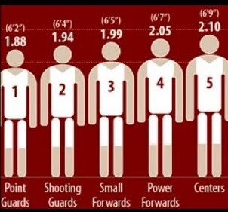
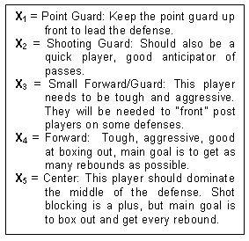
Exploring Questions and Data
Through exploring the data, we realized there were specific responsibilities of each player that may affect the stats, and possibly the salary.
Some players are needed to be more aggressive, get every rebound, anticipate passes, blocking, or focus on shooting from all areas of the court.
We became curious of data if we sorted by position on the court.

Slide 6

Data source
ESPN.com/nba
stats.nba.com
Basketball-reference.com

Slide 7




Teams Analysis
The study includes four team in California
Golden State Warriors
LA Clippers
Sacramento Kings
Lakers

Slide 8

Data Cleaning
Players Stats Dataset
Cleaning process:
Aa a aa a a
Bb b bbbb bbb
Cc CCcccc ccc
Players Salaries and Positions Dataset
Cleaning process:
Aa a aa a a
Bb b bbbb bbb
Cc CCcccc ccc

Slide 9
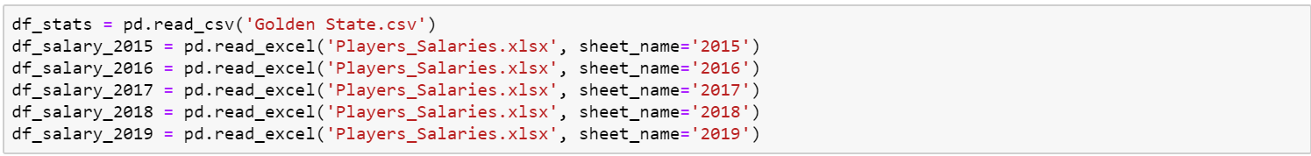
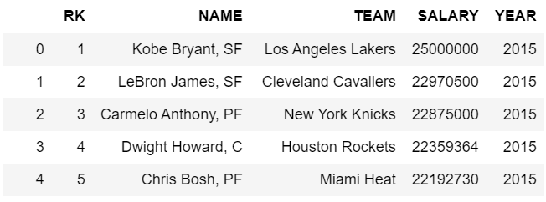
Converting Excel File w/ multiple sheets into a single data frame

Slide 10
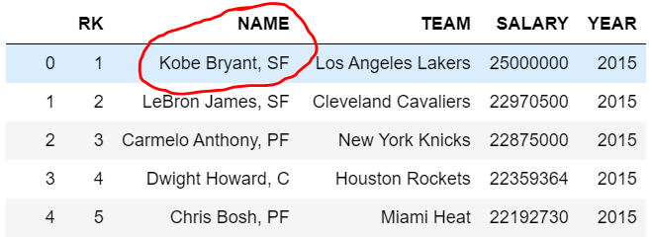
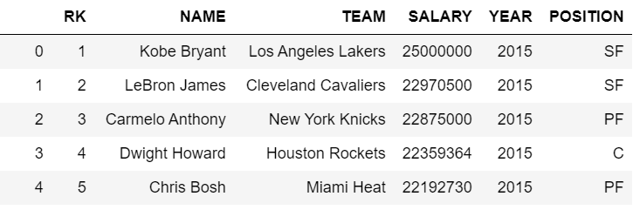
Splitting one column(Name) into two different columns (Name) and (Position)

Slide 11
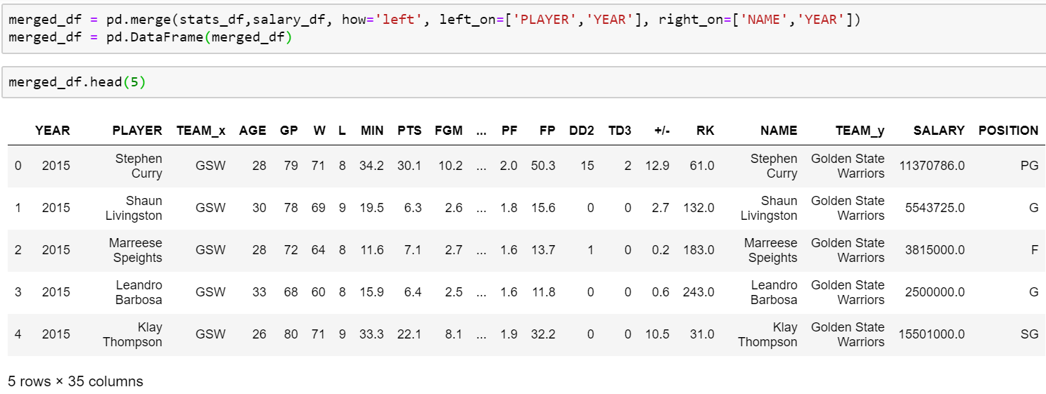
Merge Data Frames using 2 key values

Slide 12
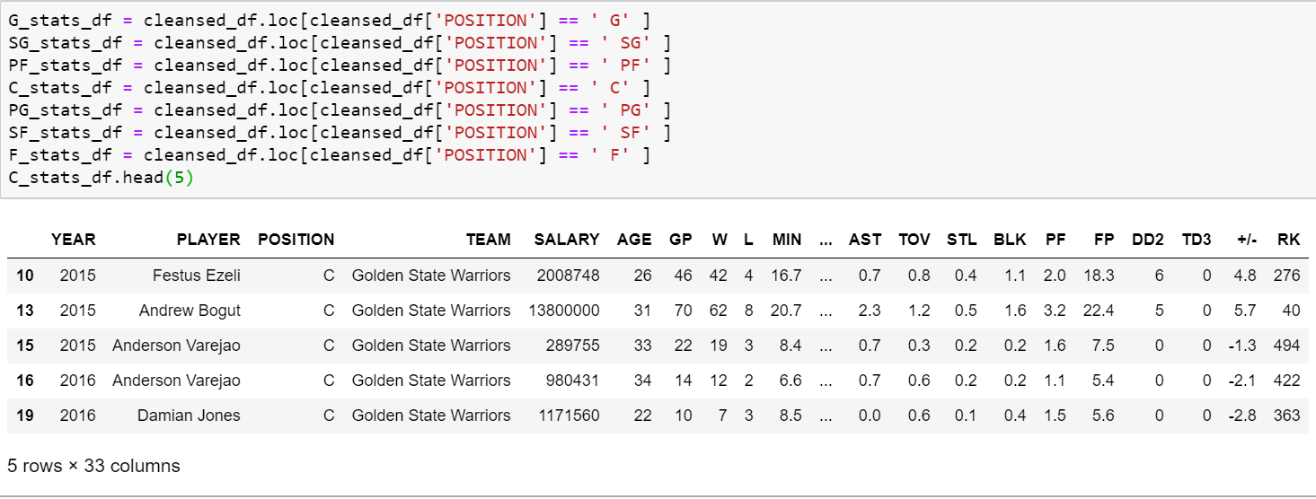
Creating Multiple Dataframes based on Position

Slide 13
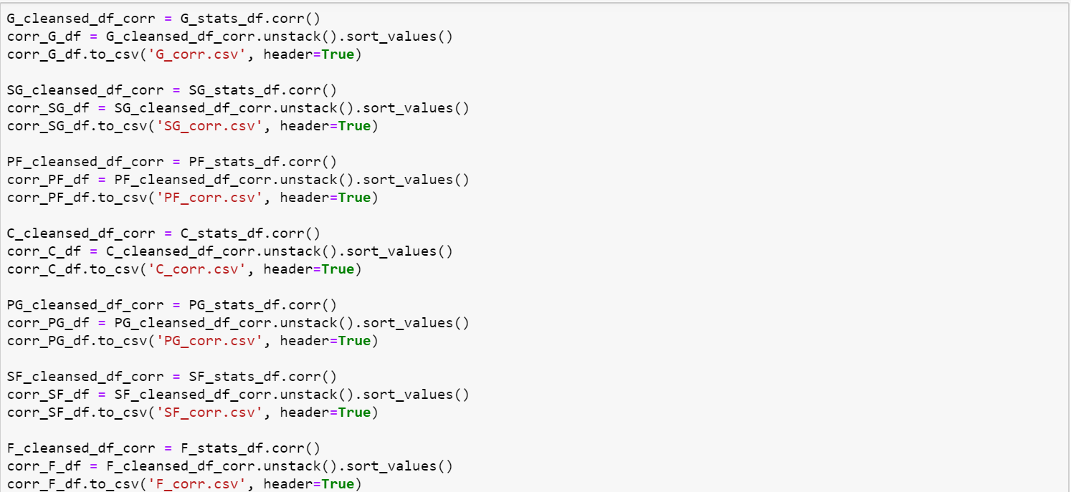
Check Correlation of all stats against salary per position

Slide 14
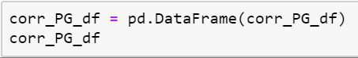
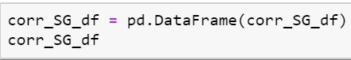
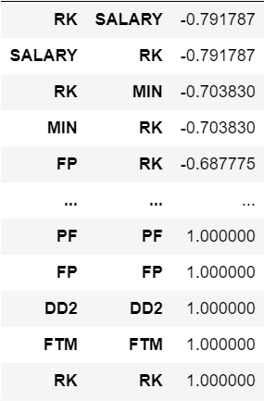
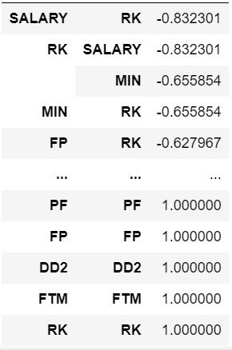
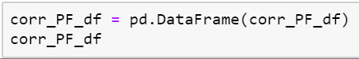
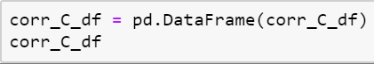
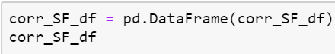
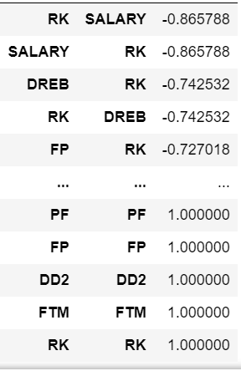
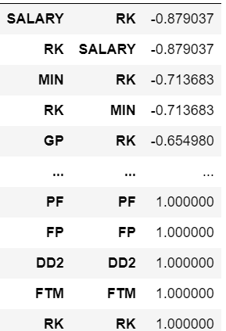
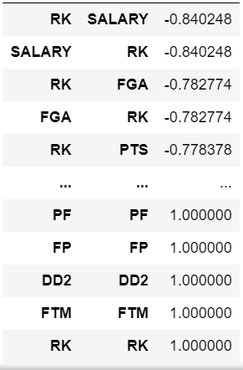
Correlation Results by Position

Slide 15
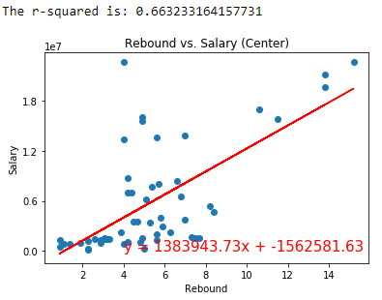
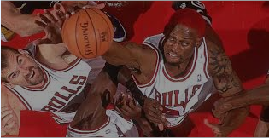
Center Position
Statistic awarded to a player who retrieves the ball after a missed field goal or free throw
Height is so important, most rebounds are made by centers

Slide 16
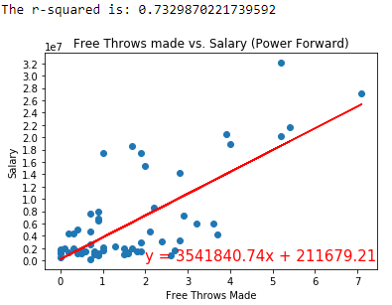
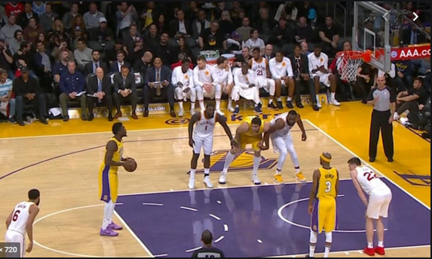
Power Forward
Free Throws are generally awarded after a foul on the shooter.
Most fouls happen inside the box.

Slide 17
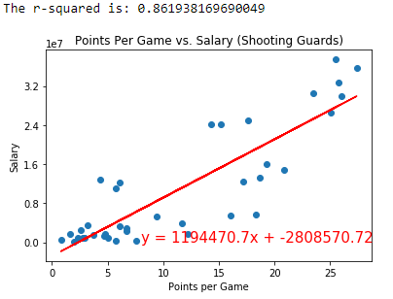

Shooting Guard
Ultimate objective of basketball is to score.
Shooting guards are known for their prolific scoring abilities.

Slide 18
Correlation Analysis process
Finding correlation for all stats vs salary for all players in four teams:
We used the correlation function (df_corr.unstack().sort_values()) in Jupyter Notebook.
Display the Data Frame in Jupyter Notebook.
Export the Data Frame to CSV
Create conditional format rule in excel to visualize the correlation between salaries for all 324 players and each stats.
Visualize the details using excel chart
-0.3 < value < 0.3 - None or very weak correlation

Slide 19
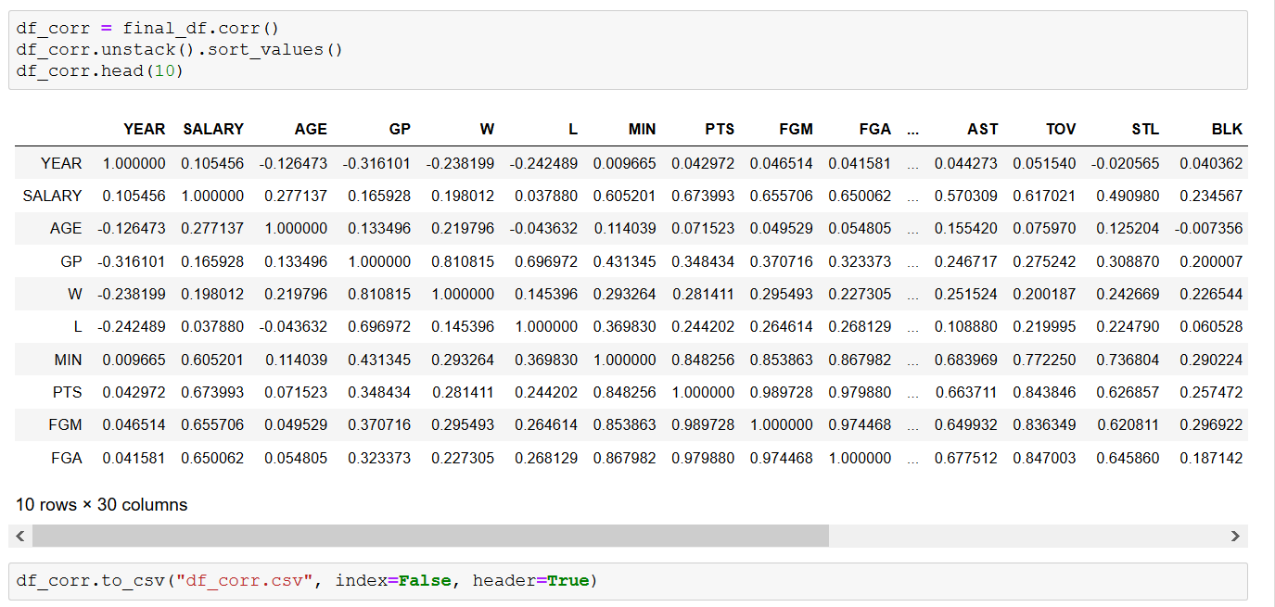
Analysis process
Finding correlation for all stats vs salary for all players in four teams:
We used the correlation function (df_corr.unstack().sort_values()) in Jupyter Notebook.
Display the Data Frame in Jupyter Notebook.
Export the Data Frame to CSV

Slide 20
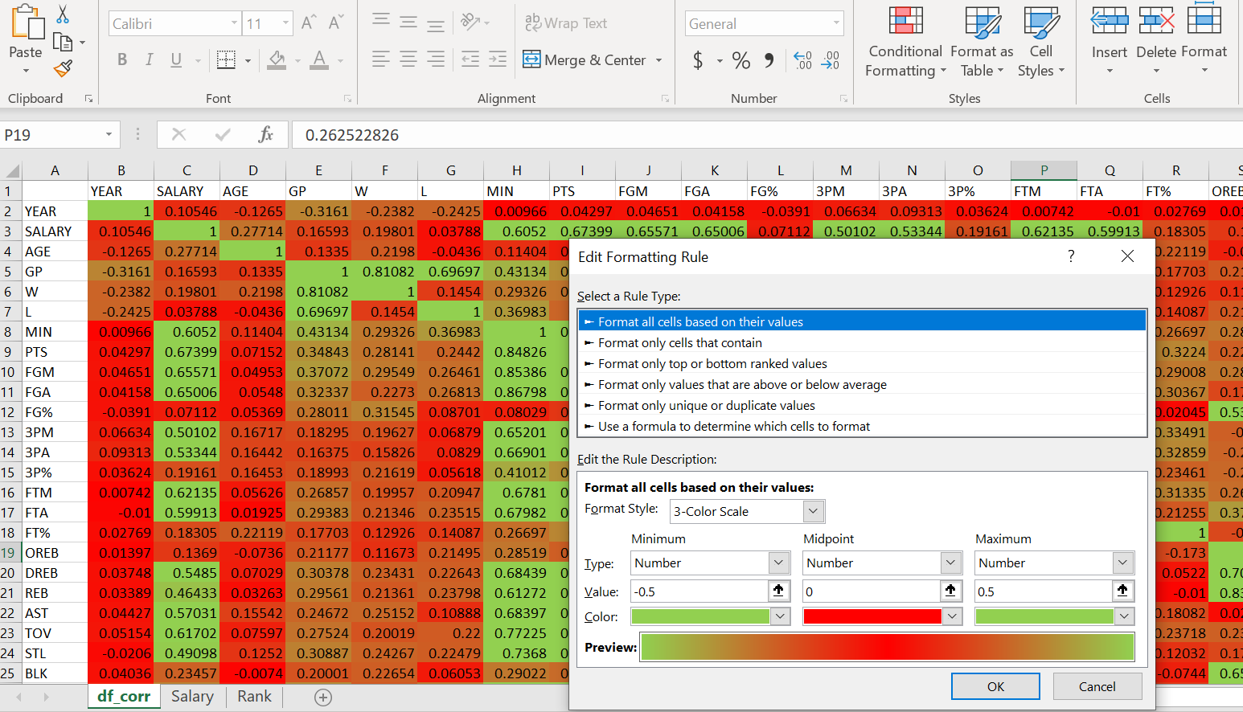
Correlation Analysis process
Finding correlation for all stats vs salary for all players in four teams:
Create conditional format rule in excel to visualize the correlation between salaries for all 324 players and each stats.
Visualize the details using excel chart
-0.3 < value < 0.3 - None or very weak correlation

Slide 21
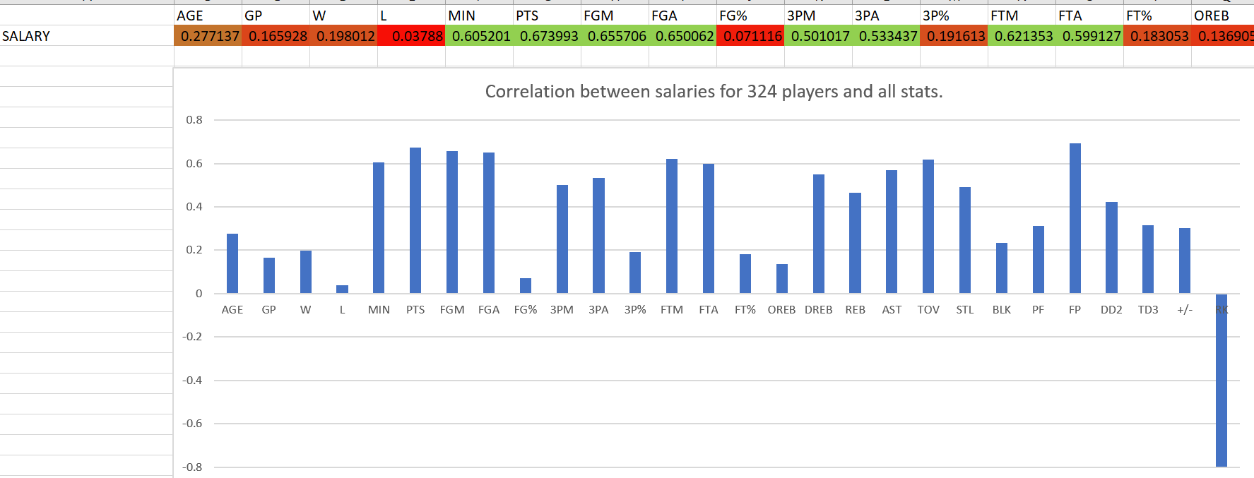
Correlation Analysis process
Finding correlation for all stats vs salary for all players in four teams:
Visualize the details using excel chart
-0.3 < value < 0.3 - None or very weak correlation

Slide 22
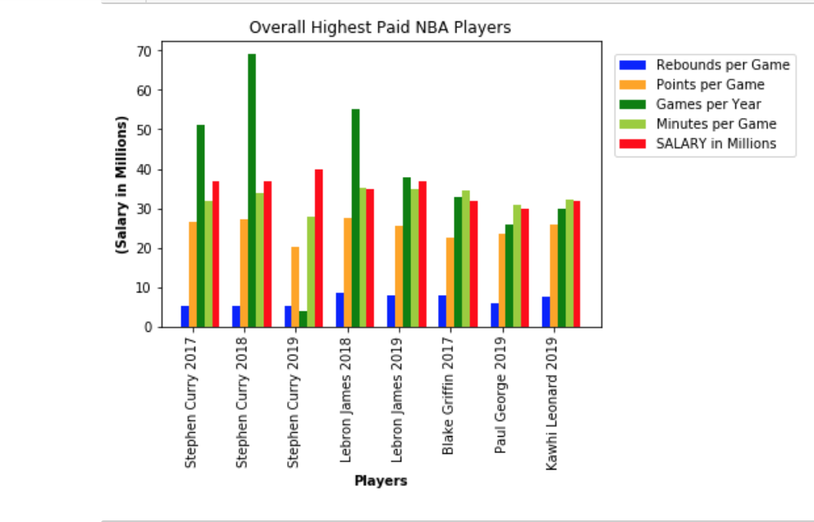
Looking for Trends
Matplotlib.pyplot allowed us to visually review our datasets through different graphs and functions.
While trends were not obvious at first, we kept trying to ask different questions.

Slide 23
Top five stats affecting salary
Points vs Salary (r - value is 0.673993)
Field goals vs Salary (r - value is 0.655705)
Field goals attempted vs Salary (r - value is 0.650062)
Minutes Played vs Salary (r - value is 0.605200)
3 Point Field Goals Made vs Salary (r - value is 0.501017)

Slide 24
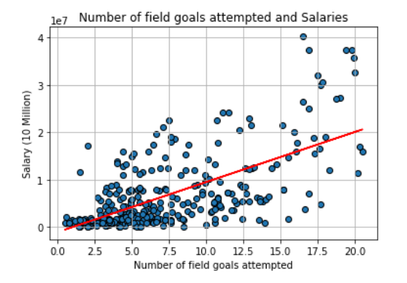
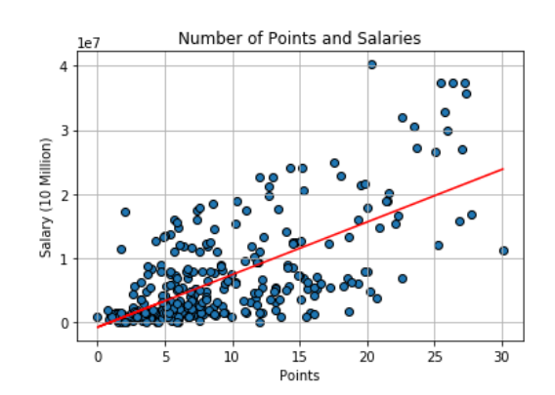
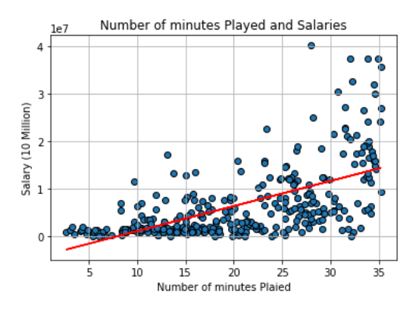
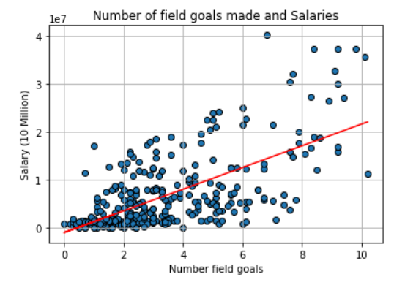
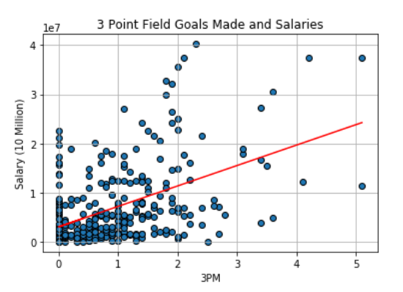
Top five stats affecting salary
Points vs Salary (r - value is 0.673993)
Field goals vs Salary (r - value is 0.655705)
Field goals attempted vs Salary (r - value is 0.650062)
Minutes Played vs Salary (r - value is 0.605200)
3 Point Field Goals Made vs Salary (r - value is 0.501017)

Slide 25
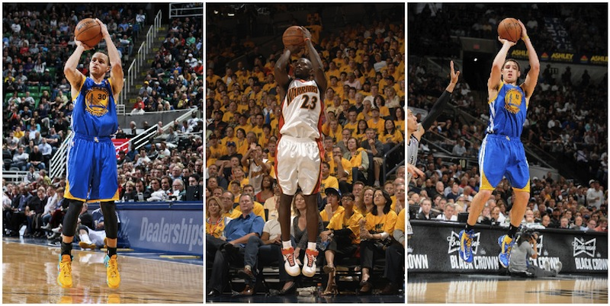
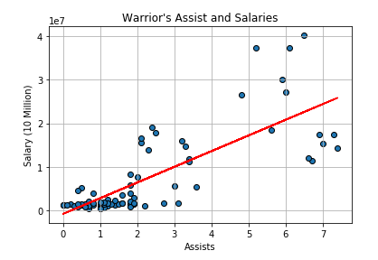
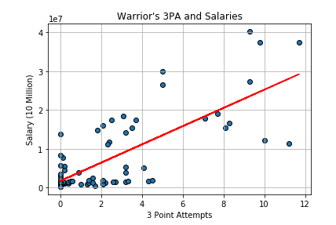

Valued Stats

Slide 26
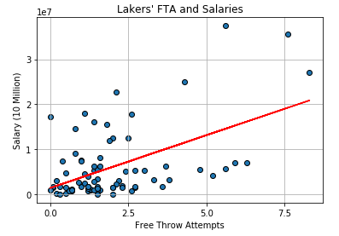
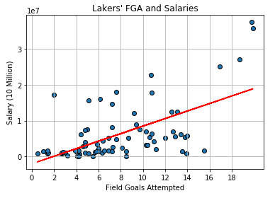
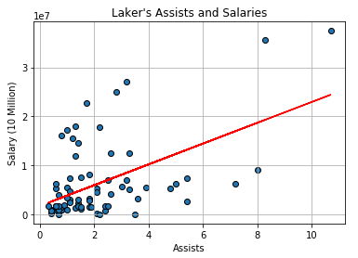
Valued Stats

Slide 27
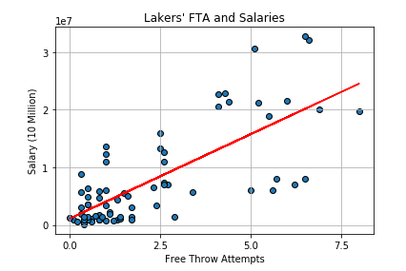
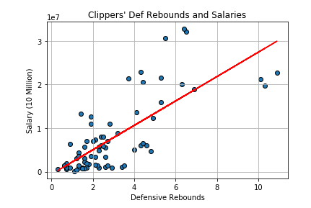
Valued Stats

Slide 28
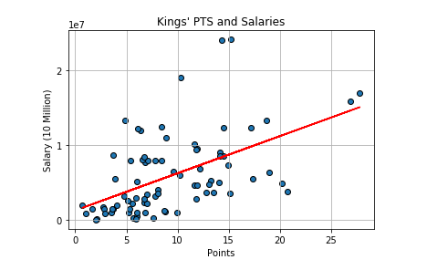
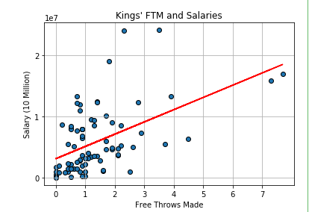
Valued Stats

Slide 29
Conclusion and Finding
-Based on our findings, the r-value has determined that ultimately, the main 5 factors affecting NBA salaries were:
Points
Field Goals Made
Field Goals Attempted
Minutes Played
3 Point Field Goals Made

Slide 30
Q & A

Slide 31
Thank you

